Slide 1
Introduction to Quantitative Statistics
Laura Perry (Academic Mentor in Health Sciences)
Task – Log into the computer and ensure you have access to the RCT paper you have chosen for your assessment as we will be referring to it throughout this lecture and we will also be using a statistical program

Slide 2
Learning Outcomes
Students will develop the ability to:
Interpret descriptive statistics in Jamovi output.
Read and understand tables and graphs presented in quantitative research papers.
Critically interpret the results sections of quantitative research papers.
Judge whether study conclusions are valid based on data presented.

Slide 3
Contents
What is statistical analysis and why we use it
Introduction to Jamovi interface
Data entry and variable types
Descriptive statistics (Mean, median, mode, standard deviation, frequencies)
Data checking and cleaning (basic)
Purpose of inferential statistics
Common statistical tests in physiotherapy research (t‑tests, Chi‑square, Correlation)
Statistical values (p values and confidence intervals)
Statistical significance vs clinical significance
Common statistical errors and misinterpretations in publications

Slide 4
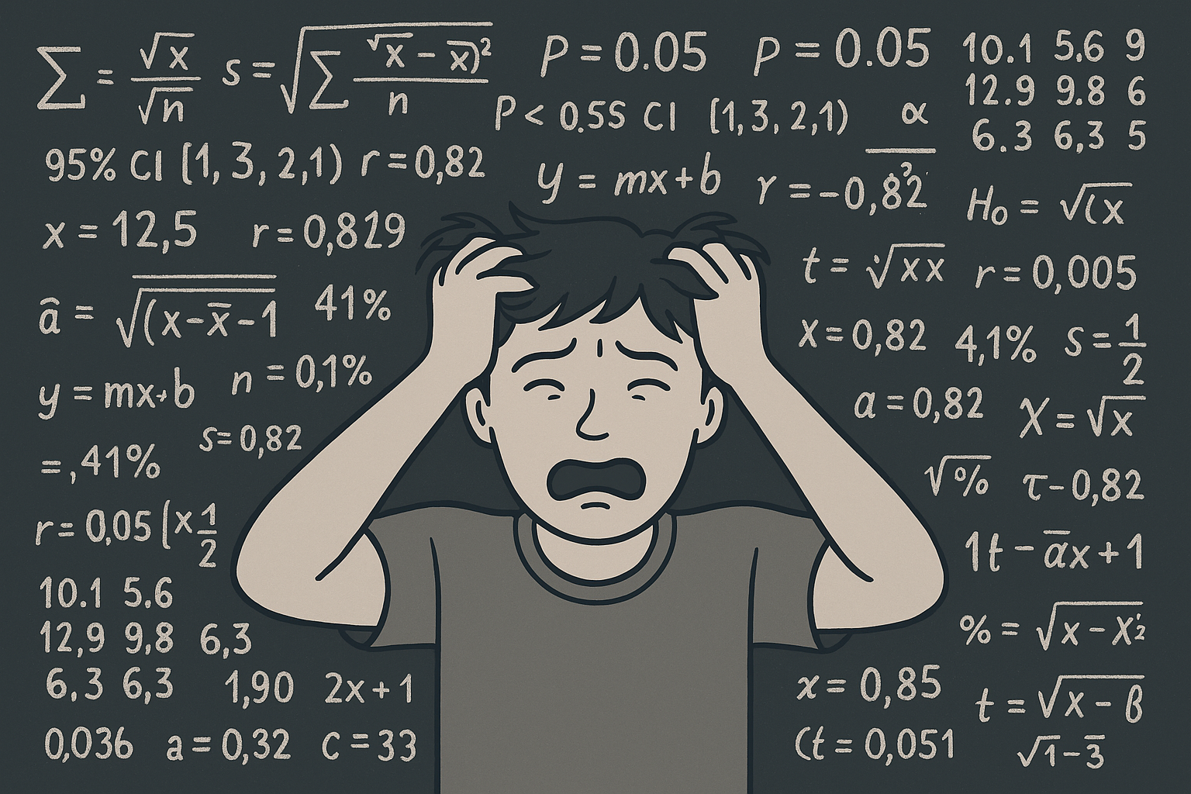

Slide 5
Statistics Analysis
A powerful tool that helps identify patterns, differences, and relationships between variables in data, using appropriate significance tests based on the data's nature and study design. It uses mathematical models to summarise data (descriptive statistics) and make predictions or inferences about a larger population based on a smaller sample (inferential statistics).

Slide 6
Why run statistical analysis?
Make Sense of Data: Turns numbers into clear information you can understand.
Check What Works: Shows if a treatment, method, or idea is really effective.
Avoid Guesswork: Helps you make decisions based on evidence, not assumptions.
Spot Patterns: Finds trends and relationships you might not see otherwise.
Example:
In physiotherapy, you might collect data on patients’ pain levels before and after a new exercise program. Statistical analysis helps you see if the improvement is real or just due to chance.

Slide 7
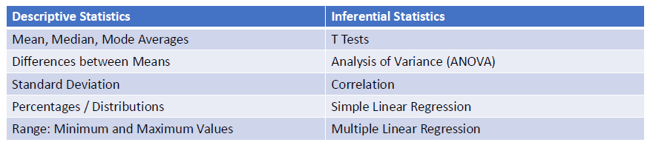
Description vs. Inferential
Two types of statistics:
Descriptive: Talking exclusively about the data and evidence you have.
Inference: Drawing broader inferences about the world by talking also about the data you do not have (i.e., the missing data).

Slide 8
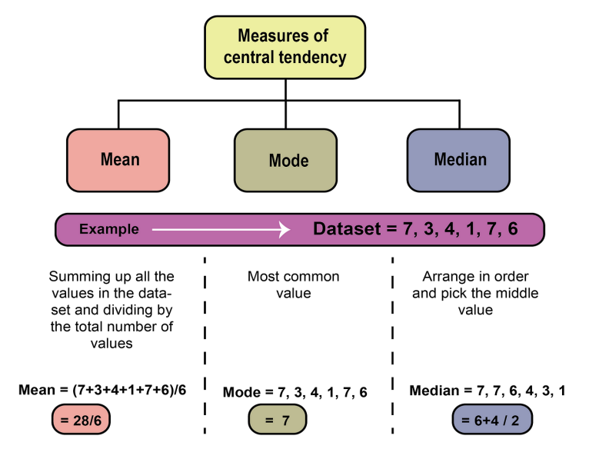
Mean, Median and Mode (i.e. Measures of Central Tendency)
Measures of central tendency estimate a dataset's average or centre, finding the result using three methods: mean, mode, and median.

Slide 9
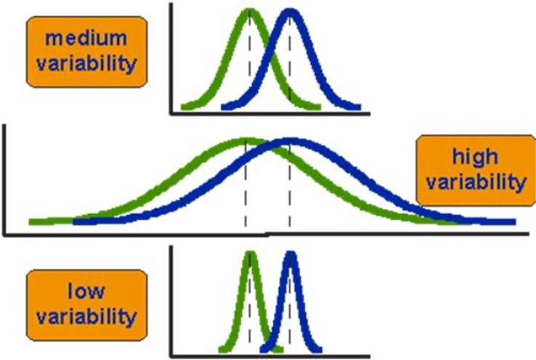
Range, IQR, standard deviation (i.e. measures of variability)
Range: difference between highest and lowest value
Interquartile Range (IQR): The range of the middle 50% of the data (difference between 75th and 25th percentiles).
Standard Deviation: The square root of the variance, expressing the average distance from the mean in the original units.

Slide 10
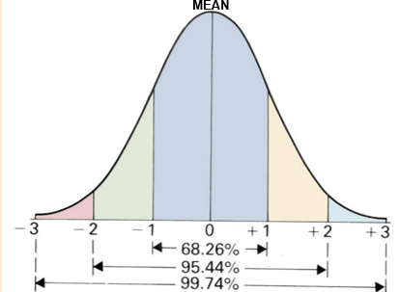
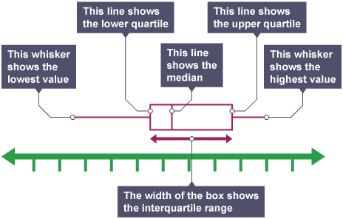
Measure of Central Tendency and Variability Pairs
Task – Look at the RCT paper you have chosen for your assessment, what measures of central tendency and variability do they use?

Slide 11
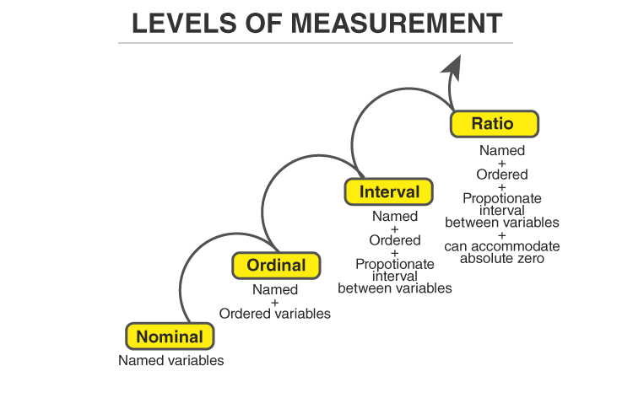
Type of data
Discrete, categorical, or ‘lower order’ data:
Nominal
Ordinal
Continuous, or ‘higher order’ data:
Interval
Ratio
Task – Look at the RCT paper you have chosen for your assessment, what types of data do they use?

Slide 12
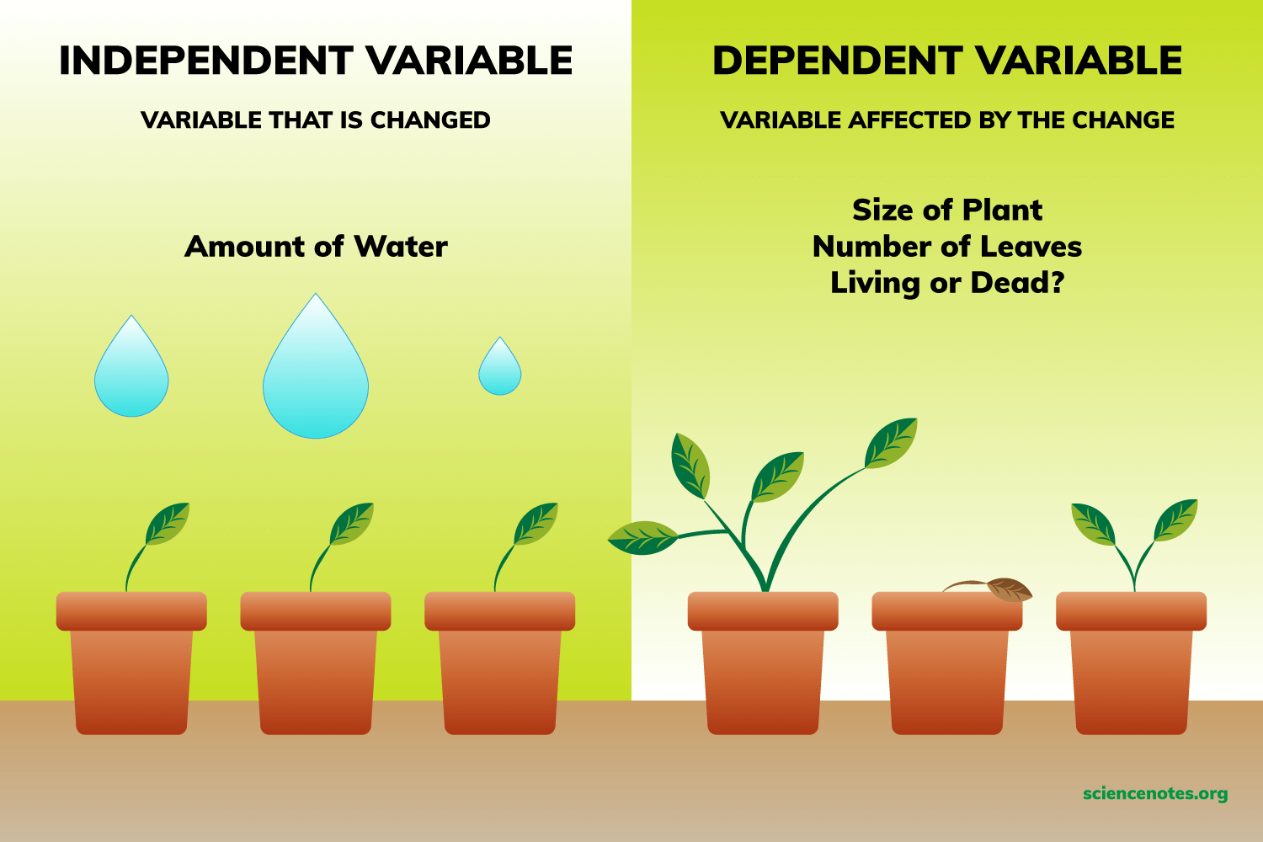
Research Variables
Task – Look at the RCT paper you have chosen for your assessment, what is the IV and DV?

Slide 13




Statistical Software

Slide 14
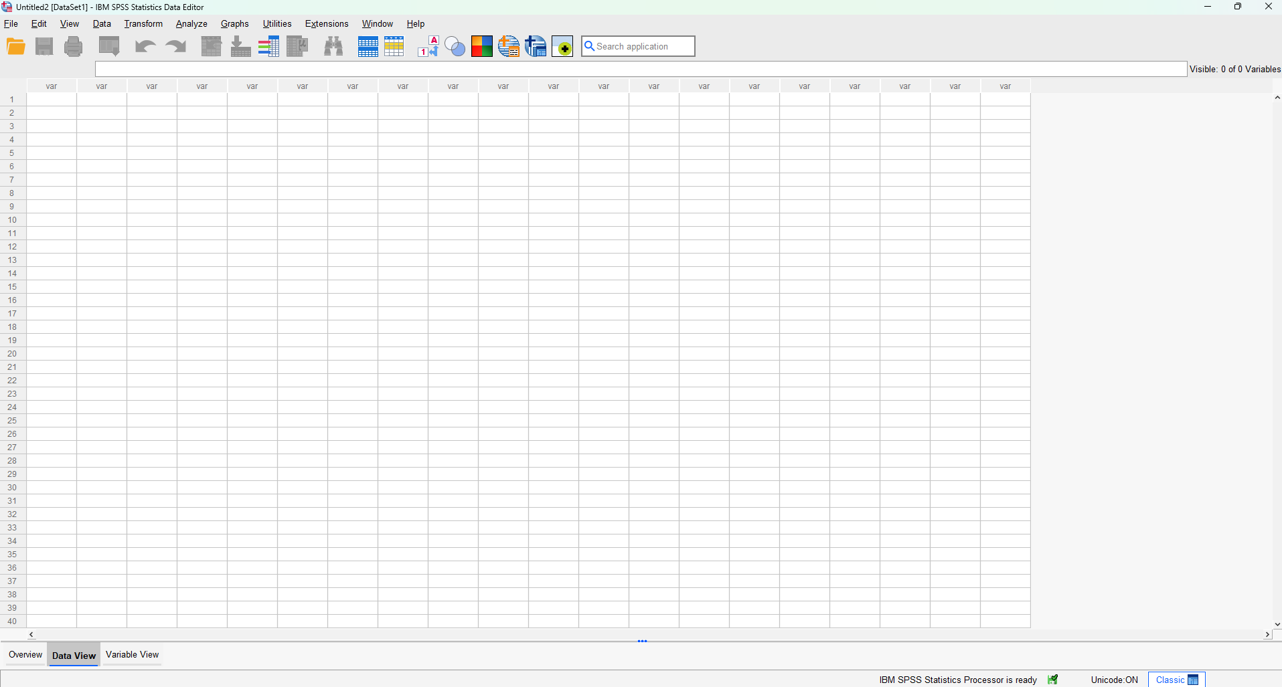
Last year: SPSS Introduction

Slide 15
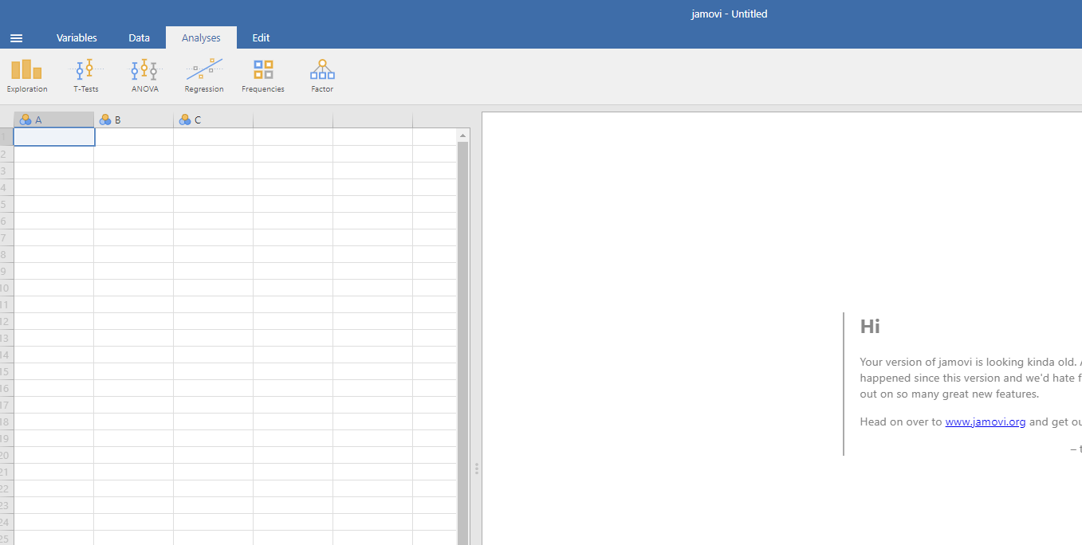
This year: Jamovi Introduction

Slide 16
Access to Jamovi
Web browser
Best for: Lightweight analyses, quick access, situations where installation is NOT possible.
Limitations: Subject to session timeouts
London Met Appsanywhere
Best for: Larger datasets, analyses that may exceed the cloud time limits, or when higher stability is needed.
OR

Slide 17
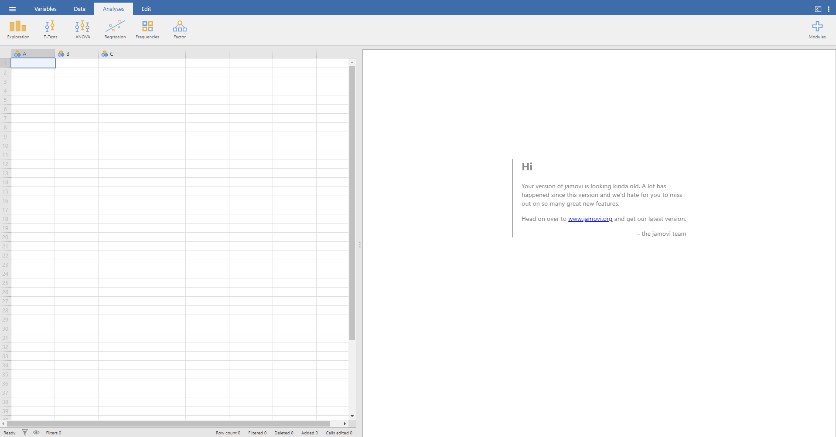

Jamovi - Basics
Menu
Ribbon
File menu (.omv)
Spreadsheet
Results Viewer
Notes:
Spreadsheet - This is where your data goes.
Results Viewer - This is where Jamovi prints out the results of any tests you run.
Menu - This has a few options - Data, Analyses, and Edit. We will mostly be using Data and Analyses. When you click any of these options, the ribbon area directly underneath changes to show you the things you can do with each option
Ribbon – a few options depending on what you click in the menu
File menu - three stacked white lines in the far-left corner - This is where you can open data sheets and save the output from JAMOVI as .omv

Slide 18
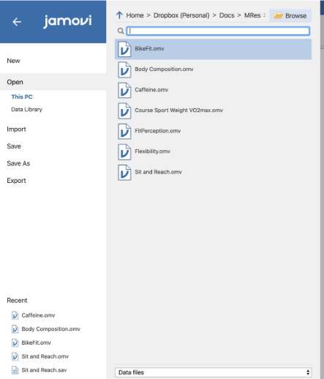
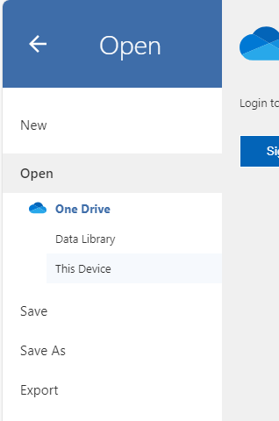
Jamovi - Basics
Download the data file from Weblearn titled ‘Jamovi dataset’-> file menu -> Open -> This PC -> Use Browse at the top right if need be ->Select the appropriate data file.

Slide 19
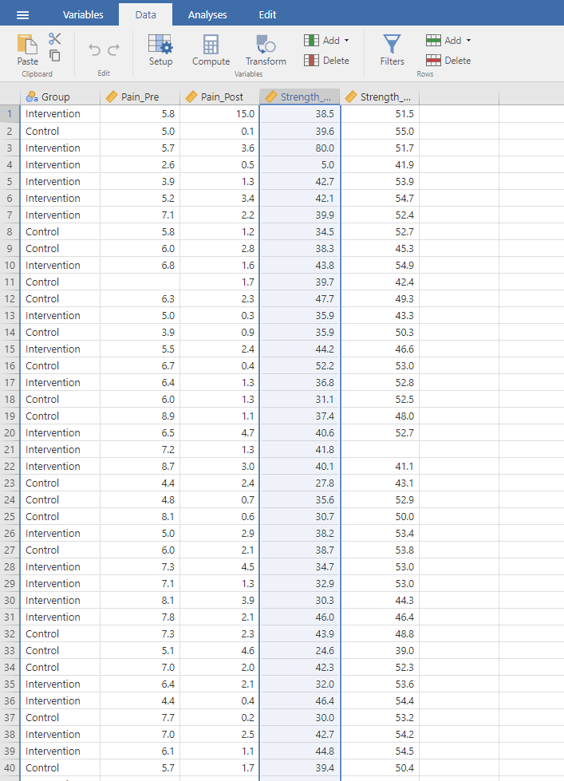
Jamovi - Basics
Data Sheet will open

Slide 20
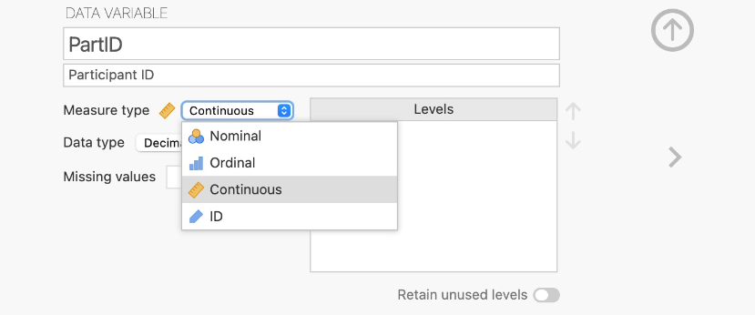
Jamovi - Basics
Different Data Types in Jamovi and the below screen appears if you double click on a variable (i.e. column) name

Slide 21
Jamovi – Descriptives
Click analyses -> exploration -> descriptives -> drag your variables from the box they are in into the variables box and the grouping variable to the split by box.

Slide 22

Data Checking and Cleaning: Why check and clean data?
Ensures your findings are accurate and trustworthy
Prevents errors that can affect your statistical results
Helps you understand your dataset before running tests

Slide 23
Data checking and Cleaning
Check for errors: Are there any unrealistic values? Is there any missing data? Does anything need correcting?
You can do this by running descriptive statistics and checking the following:
Minimum and maximum values
Missing values
N
For the ‘Jamovi dataset’, run the following: Click analyses -> exploration -> descriptives -> drag your variables from the box they are in into the variables box and the grouping variable to the split by box.
This will produce a table on the right-hand side (i.e. results viewer) -> Interpret Descriptives table using the above questions.

Slide 24
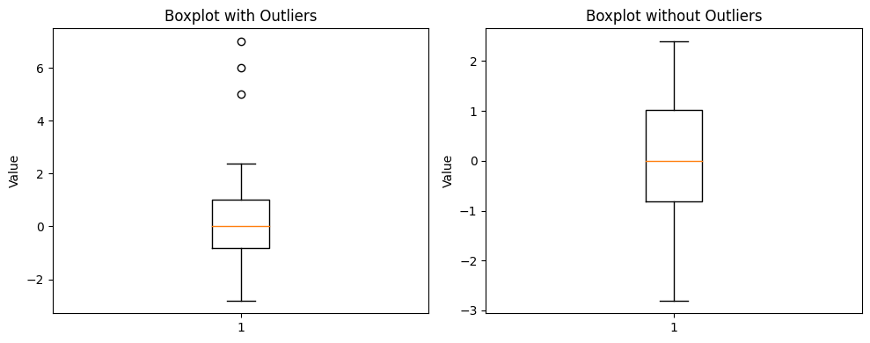
Data checking and cleaning
2. Check for outliers
You can do this by creating box plots
For the Jamovi dataset I have given you, run the following: Click analyses -> exploration -> descriptives -> drag your variables from the box they are in into the variables box and the grouping variable to the split by box -> Click the drop down ‘Plots’ -> Tick boxplots.
This will produce a box plot on the right-hand side (i.e. results viewer) -> Interpret Boxplot as per above image -> does the outlier seem real or a mistake? Keep or remove with justification.

Slide 25
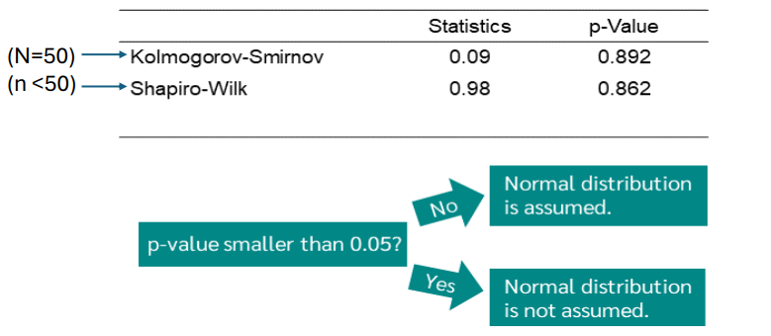
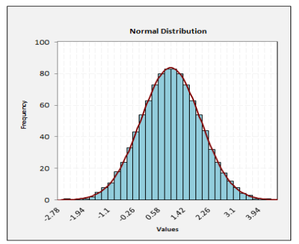
Data checking
3. Check for normality. Many of the statistics rely on the assumption that continuous data approximates a normal distribution.
You can do this by either of the following:
Check the distribution visually by a histogram
Check via a statistical value
For the Jamovi dataset, run the following: Click analyses -> exploration -> descriptives -> drag your variables from the box they are in into the variables box and the grouping variable to the group box.
-> Click the drop down ‘Plots’ -> Tick Histogram -> Click the drop down ‘Statistics’ -> Tick Shapiro-Wilk.

Slide 26
Data checking
If data is non normal, there are three options:
Transform the data
Use the nonparametric alternative
Continue with the test but acknowledge the limitations*

Slide 27

Break (15 minutes)

Slide 28
Inferential Statistics
A statistical test tells us whether a finding is likely to be real (significant) or just due to chance (nonsignificant).
We begin with the assumption that there is no difference or association (like ‘innocent until proven guilty’) (null hypothesis).
If the evidence is strong enough, we reject this assumption and conclude the finding is statistically significant. Statistical power is vital.
The systematic procedure for deciding whether the results of a research study support a particular theory which applies to a population is referred to as hypothesis testing
Task – Look at the RCT paper you have chosen for your assessment, what did the researchers hypothesise?

Slide 29
Simply
If p < 0.05 then there is a significant difference/association/relationship
If p > 0.05 then there is no significant difference/association/relationship
Activity (Physiotherapy Example):
In physiotherapy, a student collects data on twenty patients’ pain levels before and after a new exercise program. The p value for the change in pain is 0.01. Is there a significant difference in pain levels before and after a new exercise program? Please explain your answer.
Task – Look at the RCT paper you have chosen for your assessment, what p values are reported?

Slide 30
Common statistical tests in physiotherapy research (t‑tests, Chi‑square, Correlation)
t-test (Independent vs paired) – Difference test
ANOVA (between, within and mixed) – Difference test
Chi-square (goodness of fit vs Independence) – Proportion vs Association test
Correlation (Pearson’s vs Spearman's) – Association test
Task – Look at the RCT paper you have chosen for your assessment, what statistical tests have they used?

Slide 31
Common Statistical Values
Statistic | Explanation
p | p‑value tells you how likely it is that your results occurred by chance. A small p‑value (e.g., p < 0.05) suggests the result is statistically significant, meaning the observed effect is unlikely to be due to random variation.
95% CI | A confidence interval shows the range of values within which we are 95% confident the true effect lies. Wide CI = less certainty. Narrow CI = more precision. If a CI crosses 0 (for mean difference) or 1 (for ratios), the effect is usually not statistically significant.
mean difference | the difference between the average value of a variable in two groups. Example: mean pain score in intervention group − mean pain score in control group.
Relative Risk (RR) | compares the probability of an event happening in one group to another. RR = 1 → no difference RR < 1 → event is less likely in the treatment group RR > 1 → event is more likely
Intraclass correlation coefficients (ICC) | ICC measures reliability — how consistent measurements are when repeated: By the same person (intra‑rater) By different people (inter‑rater)
χ² | tests whether there is a relationship between two categorical variables.
t‑value | comes from a t‑test and reflects how big the difference between two groups is relative to the variability within the groups.
r | correlation coefficient r measures the strength and direction of the relationship between two continuous variables. Values range from –1 to +1
Task – Look at the RCT paper you have chosen for your assessment, what statistical values have they reported and what do they mean?

Slide 32

Common statistical errors and misinterpretations
1) Failing to check parametric assumptions
Parametric tests like t‑tests, Pearson correlation, ANOVA etc. have assumptions
Violating assumptions can make results misleading.
2) Using the wrong statistical test for the study design and hypothesis
3) Small sample size problems (statistical power and power analysis)
4) Multiple Comparisons Without Correction
Testing many outcomes increases the chance of false positive.
5) Selectively reporting only significant outcomes

Slide 33
Statistical significance vs clinical significance
Is the result unlikely to have happened by chance?
vs
Is the result big enough to make a meaningful difference to a patient’s life or function?
Concept | Meaning | Key Question | Example
Statistical Significance | Unlikely due to chance | Is it real? | p < 0.05
Clinical Significance | Meaningful improvement | Does it matter? | Exceeds MCID
Notes:
MCID: Minimal Clinically Important Difference

Slide 34
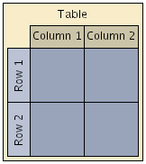
Interpreting tables
Start With the Basics
Title → What is the table about?
Rows → Groups, time points, variables?
Columns → Measurements, statistics (mean, SD, N, %)?
Identify Key Variables
What outcome is being measured? (e.g., pain, ROM, strength)
What is being compared? (e.g., control vs intervention, timepoints)

Slide 35
Interpreting tables
Read the Descriptive Statistics
What measures of central tendency are being used?
What measures of variability are being used?
Tip: Look at the table title, notes underneath, units and accompanying text to support this.
Interpret the statistical values
What statistical values are reported? (e.g. p, mean difference, 95% CI etc.)

Slide 36
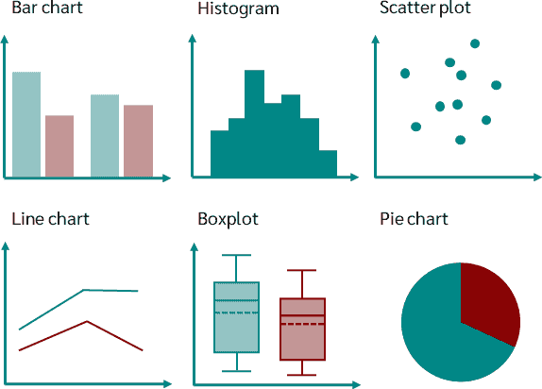
Interpreting Graphs
Start With the Basics
Title → What is the graph about?
Type of Graph:
Bar chart → comparing groups
Line graph → changes over time
Scatter plot → relationships/correlations
Box plot → spread and medians
Axes:
X‑axis = what is being measured over time, groups, or conditions.
Y‑axis = the outcome variable (e.g., pain score, ROM, strength).

Slide 37
Interpreting Graphs
Look for Key Patterns
Is the trend increasing, decreasing, or flat?
Are groups moving in different directions?
Is there overlap between groups?
Check Variability and Precision
Error bars = standard deviation, standard error or confidence intervals
Wide bars → more variability / less certainty
Narrow bars → more consistent data
Does the graph match the conclusions made by the authors of the study?

Slide 38
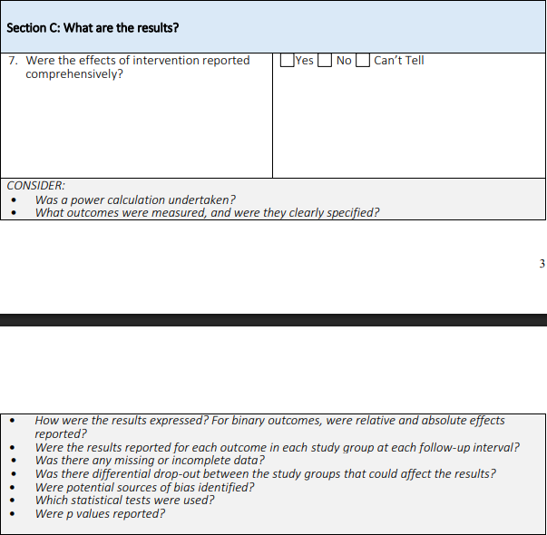
CASP Tool: Section C and Your RCT

Slide 39
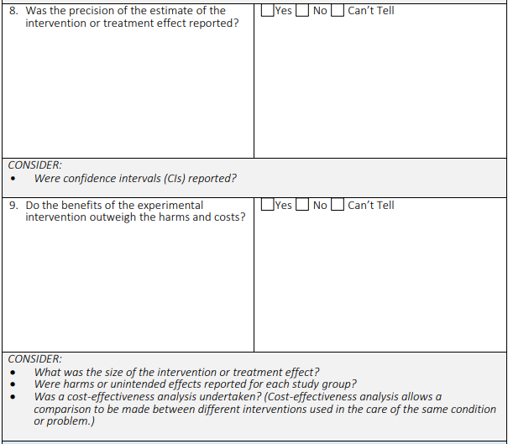
CASP Tool: Section C and Your RCT

Slide 40
Any Questions?

